Slide 1
Onboarding screens flow

Slide 2

Page 1

Slide 3

Page 2

Slide 4

Page 3

Slide 5

Page 4

Slide 6
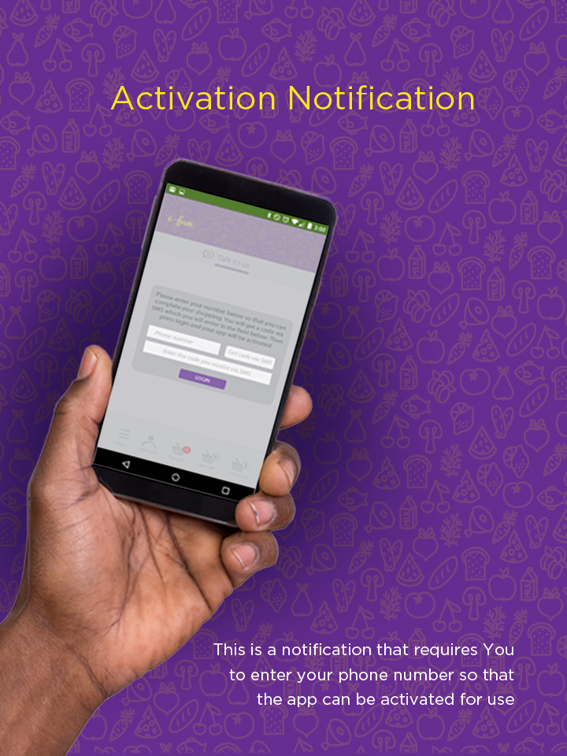
Page 5

Slide 7
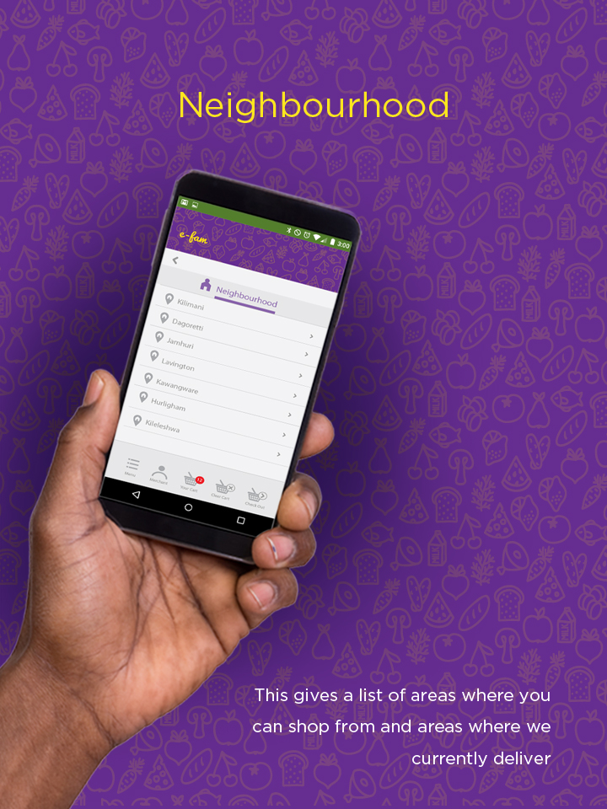
Page 6

Slide 8

Page 7

Slide 9
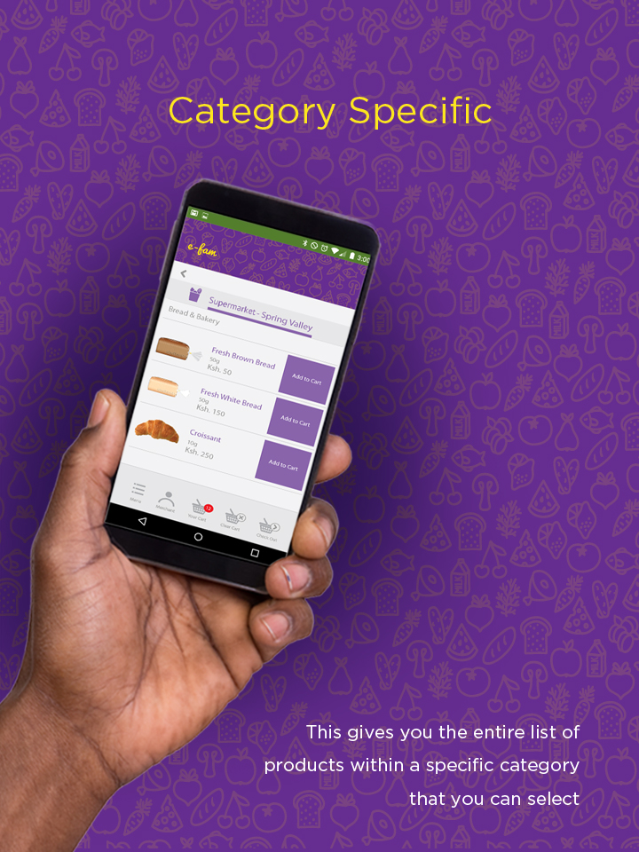
Page 8

Slide 10
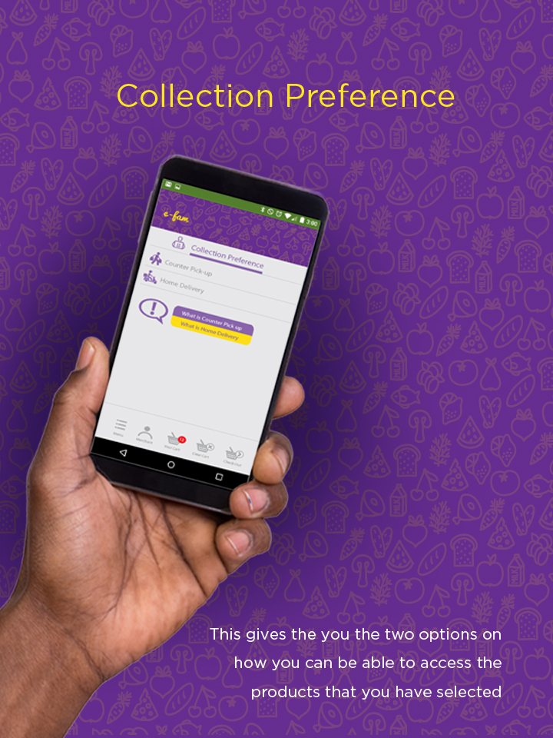
Page 9

Slide 11

Page 10

